Slide 1
FINAL PRESENTATION
The role of tissue-specific antigens in different cancer entities
KALLIKREIN GENES
Anouk Dupé, Dustin Schilling, David Eckey, Maria Yemane
Supervisor: Dr. Maria Dinkelacker
Tutor: Nils Mechtel
21.07.2021

Slide 2

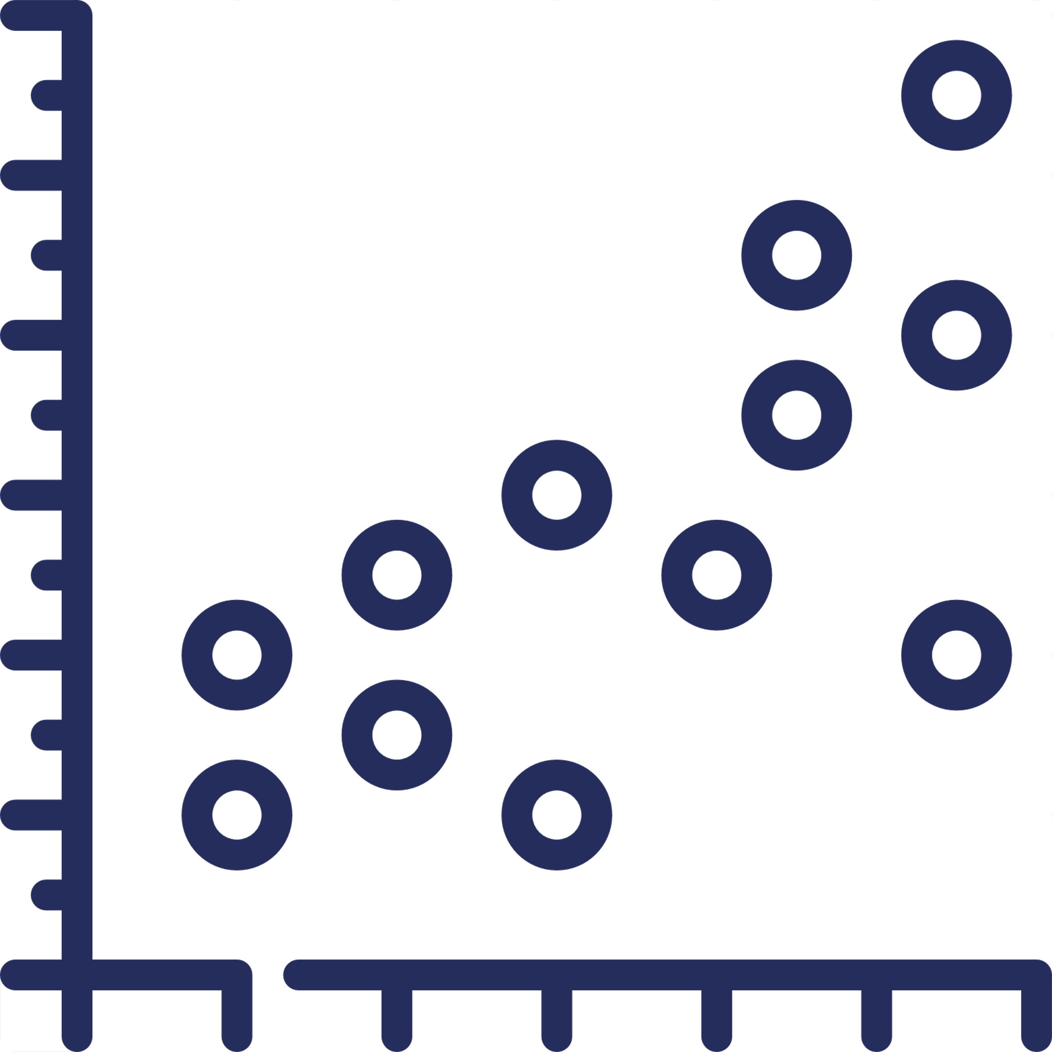


Agenda
Biological background
01
Breast cancer
02
Lung cancer
03
Outlook
04
21.07.21
Final presentation – kallikrein gene
2

Slide 3

Biological background and aim of the project
1
2
3
4
Background
Breast cancer
Lung cancer
Disscussion
tissue restricted antigens (TRAs) show upregulation in cancer
TRAs can serve as biomarkers and/or potential drug targets
kallikrein genes (KLKs) are a group of serine
proteases under steroid hormone regulation
„Deviations in expression patterns of specific KLKs?“
potential in serving as biomarkers?
involved in tissue remodelling
regulation blood pressure
skin desquamation
21.07.21
Final presentation – kallikrein gene
3
Notes:
Tissue specific antigens are genes that have higher prevalences in specific tissues than in others.
Due to negative selection in the thymus of t cells that are specific for those TRAs, our immune system doesnt react to TRAs.
This leads to over up-regulation of TRAs in some cancer tissues without immune reaction. On the other hand, those overexpressions
May serve as indicators for cancer or even as drug targets. Kallikreins, a gene family of 15 serine proteases, serve due to ist tissue specificity a potential biomarker and is already of high interest in cancer research.
The aim of this project was to analyse two given datasets, of lung and breast cancer, and to screen for interesting expression values of specific kallikrein genes, that may indicate a potential use as biomarkers.

Slide 4
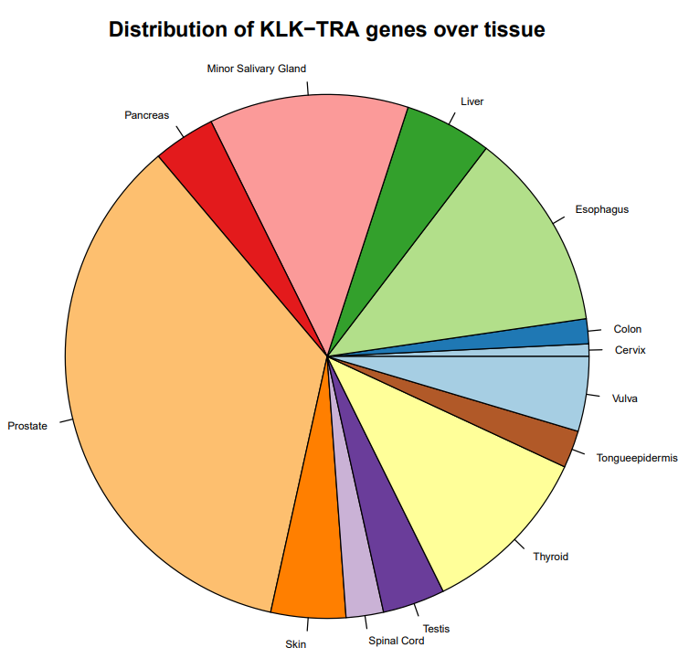
TRA distribution
1
2
3
4
Background
Breast cancer
Lung cancer
Disscussion
→ six TRA data sets
→ creation union KLK data set
→ removal identical entries
21.07.21
Final presentation – kallikrein gene
4
Notes:
Piechart
To get overview about distribution of kallikrein genes that are TRA
Shows high prevalences in Prostate, Minor Salivary Gland, Esophagus and Thyroid

Slide 5
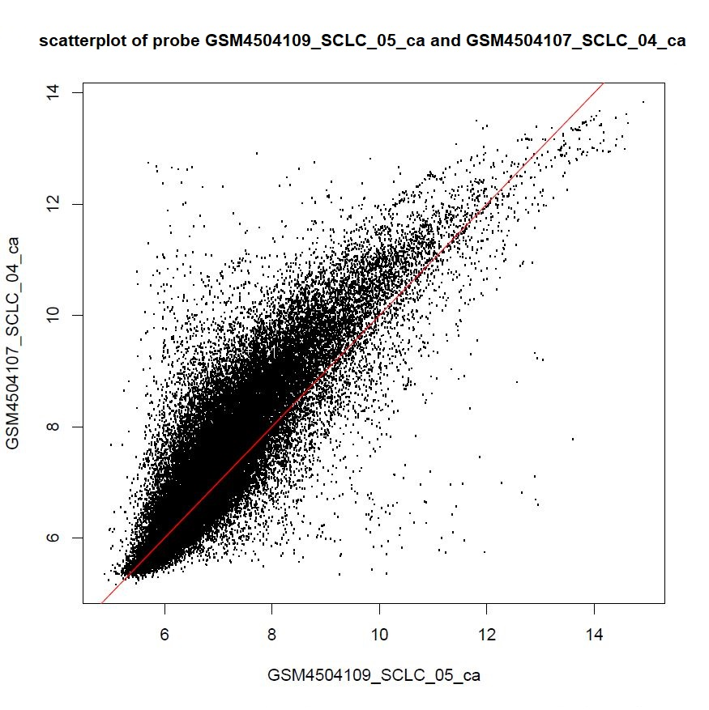
Quality control
1
2
3
4
Background
Breast cancer
Lung cancer
Disscussion
→ scatterplot from lung cancer data set
→ “banana form“ detectable
→ exchange of two chips
analogous QC presented by Dr. Maria Dinkelacker in “R Course Micoarray Analysis”
21.07.21
Final presentation – kallikrein gene
5
Notes:
QC
Followed the steps presented in “R Course Micoarray Analysis” by Dr.Maria Dinkelacker
Here you can see scatter plot of two chips from lung cancer data set
Plottet chips against each other – non linear relationship indicate deviations in chip
Exchange of chip no.5 – na and ca

Slide 6
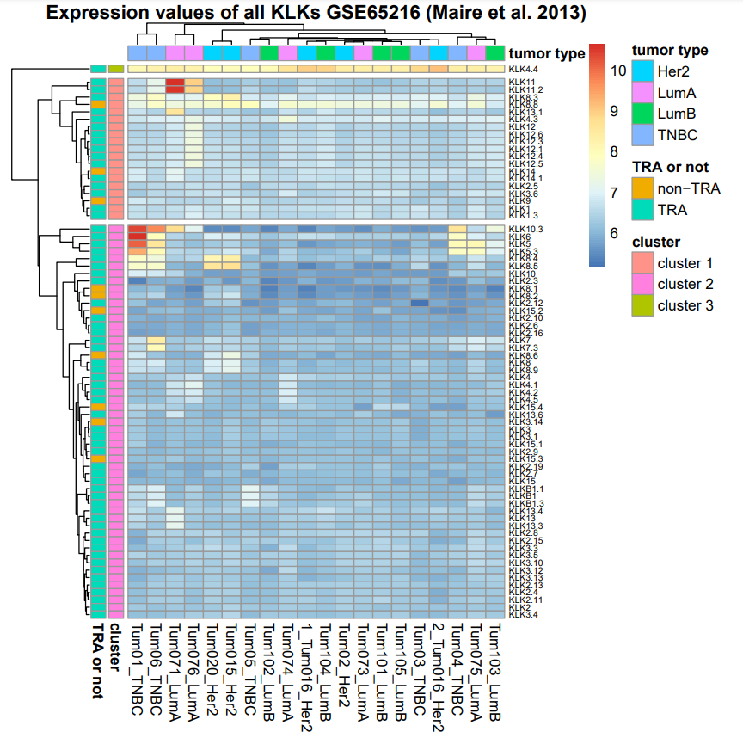
Breast cancer - heatmap
1
2
3
4
Background
Breast cancer
Lung cancer
Disscussion
20 samples
four mutation: TNBC, Her2, LumA, LumB
73 KLK transcripts
63 TRAs
21.07.21
Final presentation – kallikrein gene
6

Slide 7
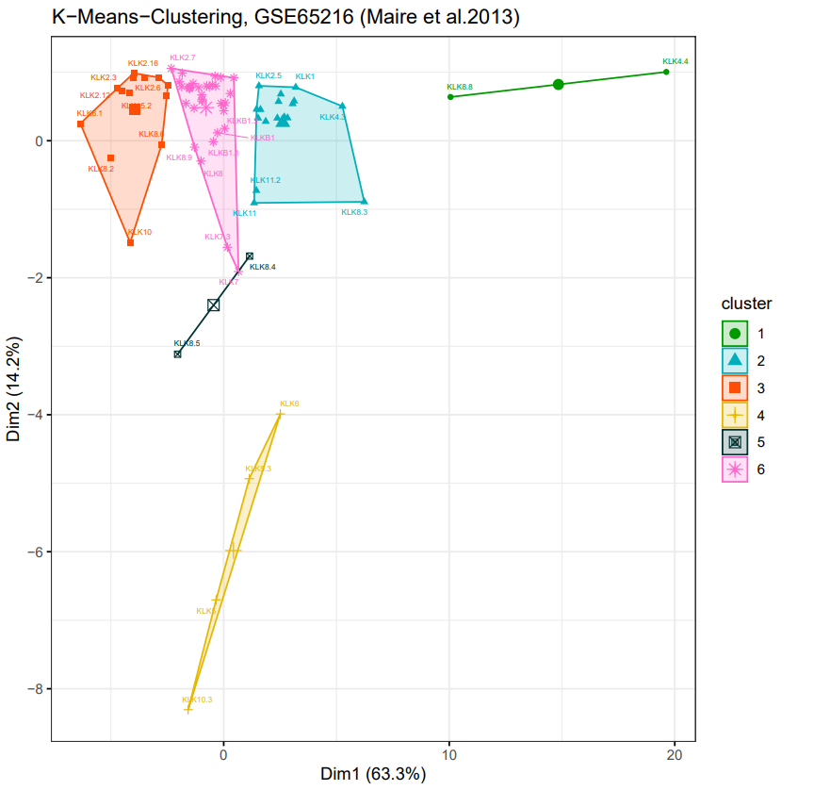
Breast cancer - k-means
1
2
3
4
Background
Breast cancer
Lung cancer
Disscussion
→ cluster analysis for KLK genes
→ two potentially interesting clusters
→ cluster 1: KLK4.4 and KLK8.8
→ cluster 4: KLKs 5, 5.3, 6 and 10.3
21.07.21
Final presentation – kallikrein gene
7
Notes:
Optimal number of clusters was detected using a withing sum of squares plot
Six clusters werde build, two of them distinct with interesting genes:
Cluster 1 (Green) contains KLKs 4.4 and 8.8 that were already distinct in heatmap
Cluster 4 (yellow) contains KLK 5, 5.3, 6 and 10.3
→ These results will be analysed later on in the hypothesis testing

Slide 8
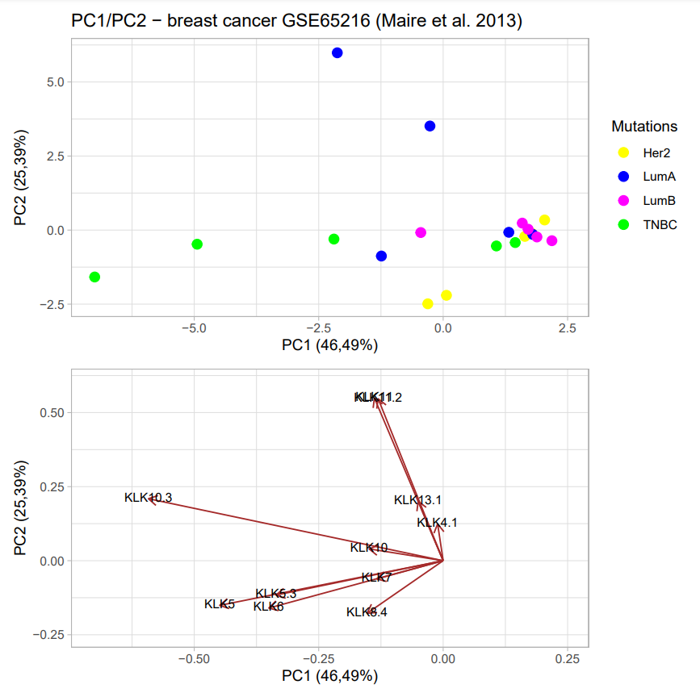
Breast cancer - PCA
1
2
3
4
Background
Breast cancer
Lung cancer
Disscussion
→ cumulative variance: 72%
→ two LumA samples highly influenced by KLK11
→ three TNBC samples influenced by KLK5,5.3,6
→ clustered samples with no differentiation
21.07.21
Final presentation – kallikrein gene
8

Slide 9
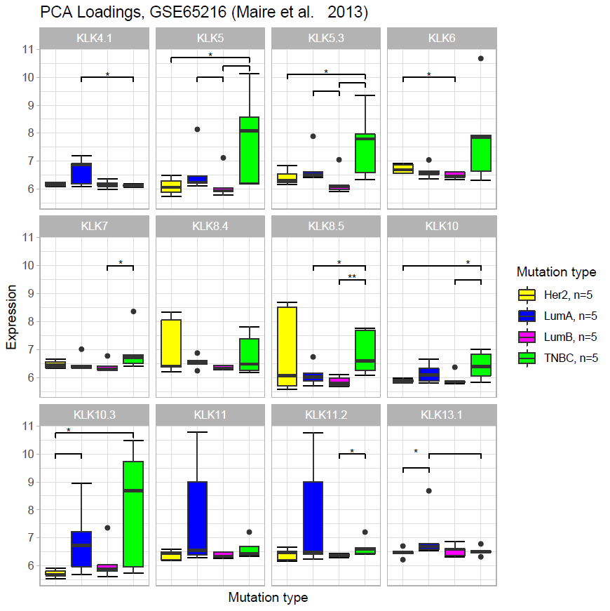
Breast cancer - hypothesis testing
1
2
3
4
Background
Breast cancer
Lung cancer
Disscussion
→ upper tail Wilcoxon-Mann-Whitney test
→ LumA over-expression in KLK11 not significant
→ TNBC over-expression in KLK5, KLK5.3 significant
→ no specific expression pattern for Her2, LumA, LumB
Final presentation – kallikrein gene

Slide 10
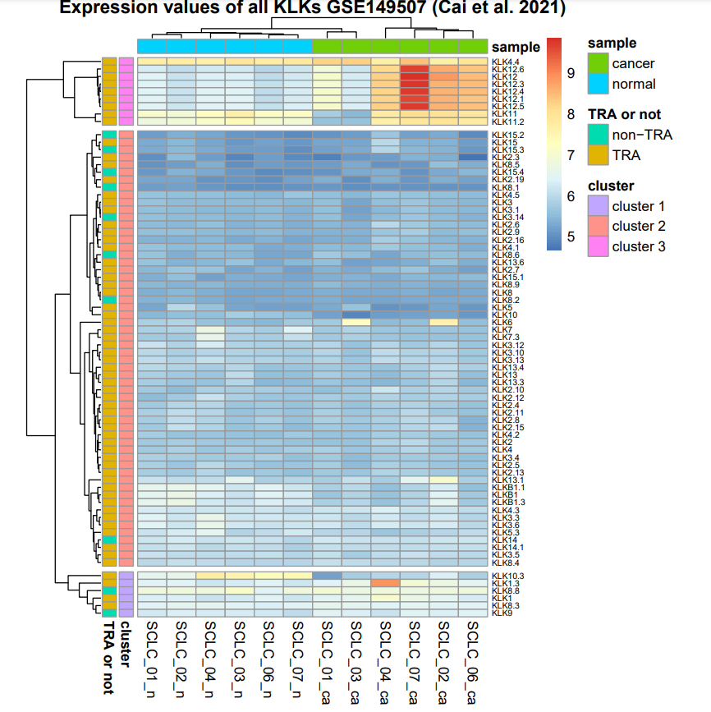
Lung cancer - heatmap
1
2
3
4
Background
Breast cancer
Lung cancer
Disscussion
twelve samples
six patients with small cell lung cancer
carcinoma and normal tissue samples
21.07.21
Final presentation – kallikrein gene
10

Slide 11
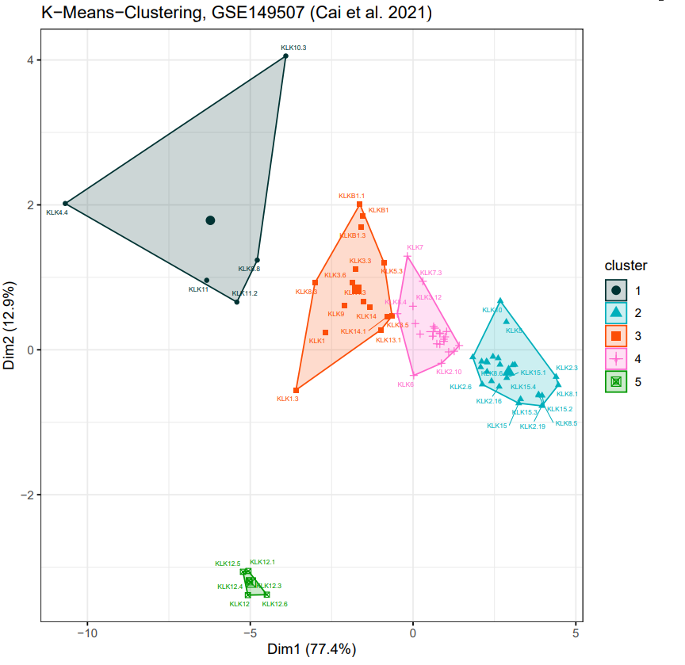
Lung cancer - k-means
1
2
3
4
Background
Breast cancer
Lung cancer
Disscussion
→ cluster analysis for KLK genes
→ cluster 5 distinct
→ KLK12 & isoforms
→ cluster 1: KLKs 4.4, 10.3, 11 and 8.8
21.07.21
Final presentation – kallikrein gene
11
Notes:
again, a within cluster sum of squares plot was used to determine optimal number k of clusters
Five clusters, of which especially the fifth one is really distinct
Consisting of KLK12 and ist isoforms
Cluster 1 contains genes that are already of interest and also stood out in heatmap, so their expression will allso be analysed in hypothesis testing

Slide 12
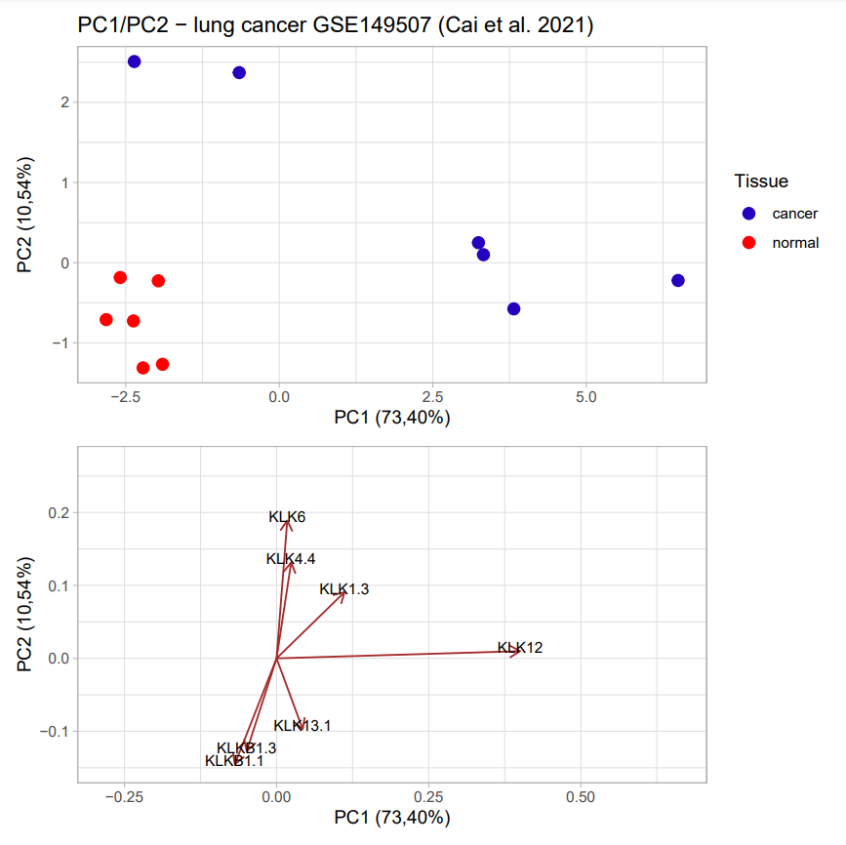
Lung cancer - PCA
1
2
3
4
Background
Breast cancer
Lung cancer
Disscussion
cumulative variance: 85%
KLK12 marker for four microchips
21.07.21
Final presentation – kallikrein gene
12

Slide 13
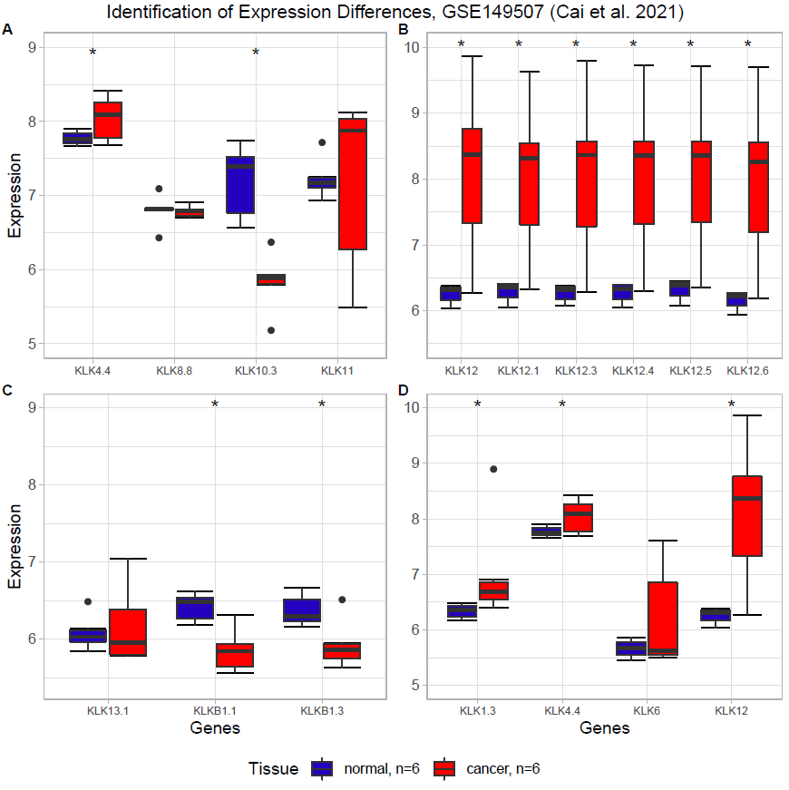
Lung cancer - hypothesis testing
1
2
3
4
Background
Breast cancer
Lung cancer
Disscussion
→ Wilcoxon-signed rank test
→ KLK10.3 upregulated in lung cancer → reduces proliferation
→ KLK12 upregulated in lung → pro-angiogenic factor
→ expression is significantly different in the tissues for most of the identified genes
Final presentation – kallikrein gene

Slide 14
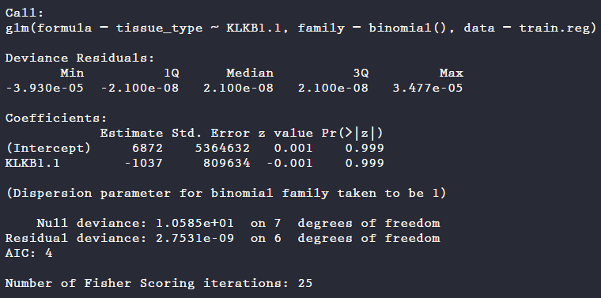
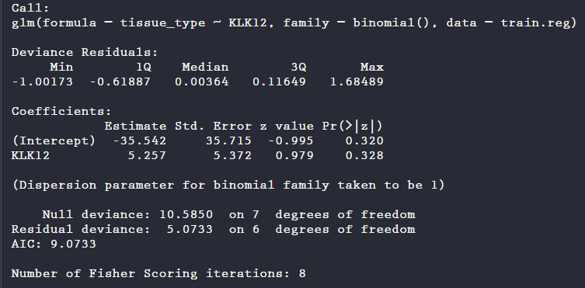
Lung cancer - logistic regression analysis
1
2
3
4
Background
Breast cancer
Lung cancer
Disscussion
Overfit model with KLKB1.1
Regression model with KLK12
→ main reason for overfit: low sample size
Predictions
→ p-value not significant
→ High uncertainty
Final presentation – kallikrein gene

Slide 15



Conclusion and outlook
1
2
3
4
Background
Breast cancer
Lung cancer
Disscussion
Results
breast cancer:
few overexpression
lung cancer:
different expression
in carcinoma and healthy tissue
Note
No breast cancer healthy tissue
Small number of samples
Outlook
Comparative value with healthy tissue
More samples for analysis
Kallikrein genes are possible good biomarkers
21.07.21
Final presentation – kallikrein gene
15

Slide 16

Questions?
1
2
3
4
Background
Breast cancer
Lung cancer
Disscussion
21.07.21
Final presentation – kallikrein gene
16

Slide 17
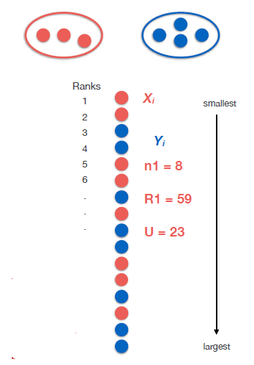
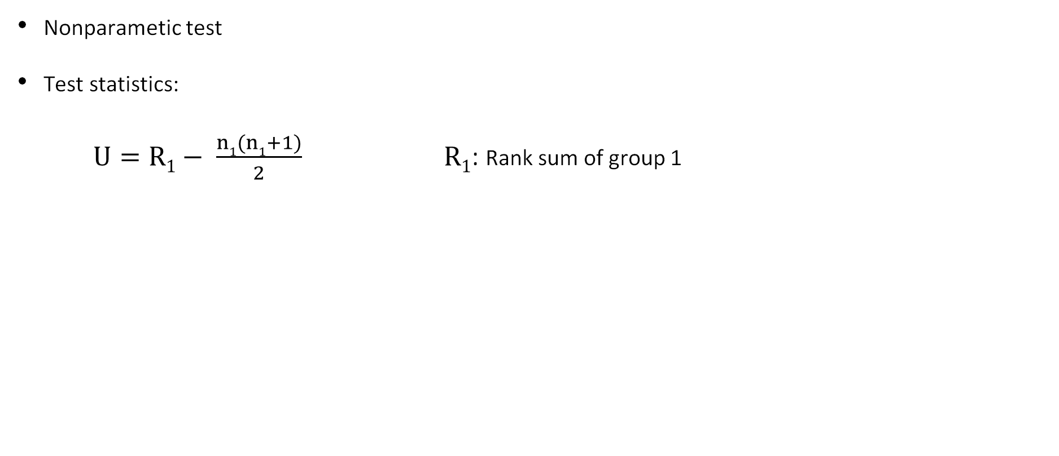
Theory of the Wilcoxon-Mann-Whitney test
Nonparametic test
Test statistics:
$U=R1− \frac{n1(n1+1)}{2}$ $R1$: Rank sum of group 1
Carl Herrmann, Health Data Science Unit - Medizinische Fakultät Heidelberg
21.07.21
Final presentation – kallikrein gene
17

Slide 18
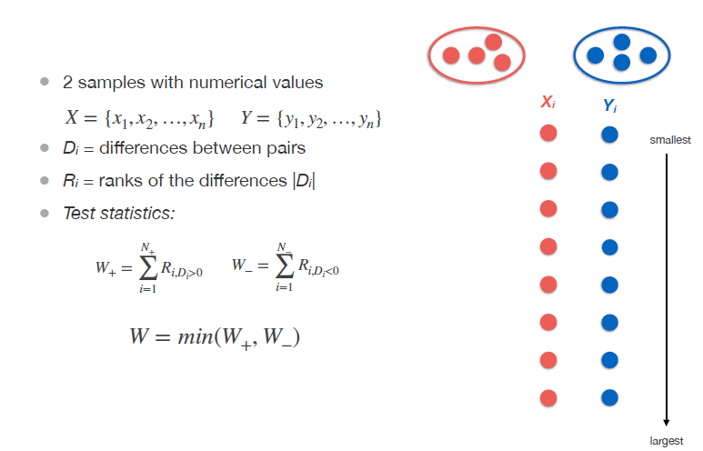
Theory of the Wilcoxon signed rank test
Carl Herrmann, Health Data Science Unit - Medizinische Fakultät Heidelberg
Final presentation – kallikrein gene

Slide 19
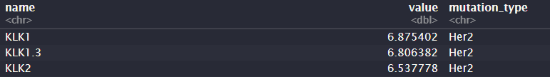
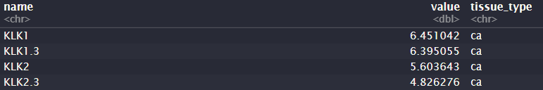
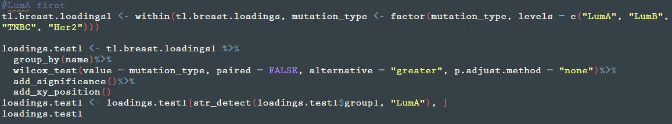
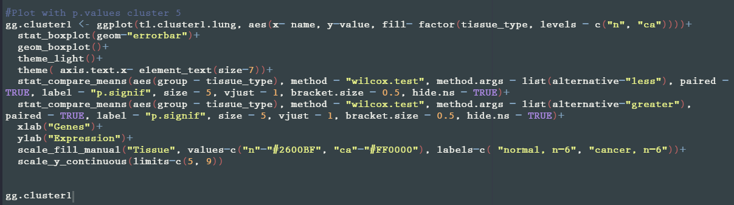
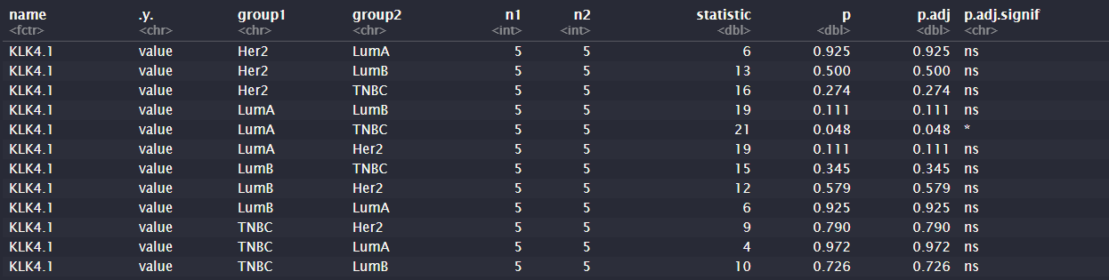
Data structure for hypothesis testing
Maire et al., 2013
Cai et al., 2021
Input structure
Input structure
Main command
Main command
Output

Slide 20
Assumptions for logistic regression
1. Independence of errors, every observation has to be separate from the others.
2. Linearity of the continuous variables in logit - the relationship between the variable and their logit transformed outcome should be linear.
3. Absence of multicollinearity or redundancy
4. No outliners with a strong influence.
5. For every independent variable there should be at least ten outcomes
(Stoltzfus 2011)

Slide 21
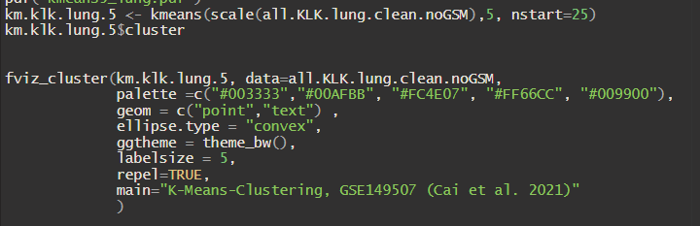
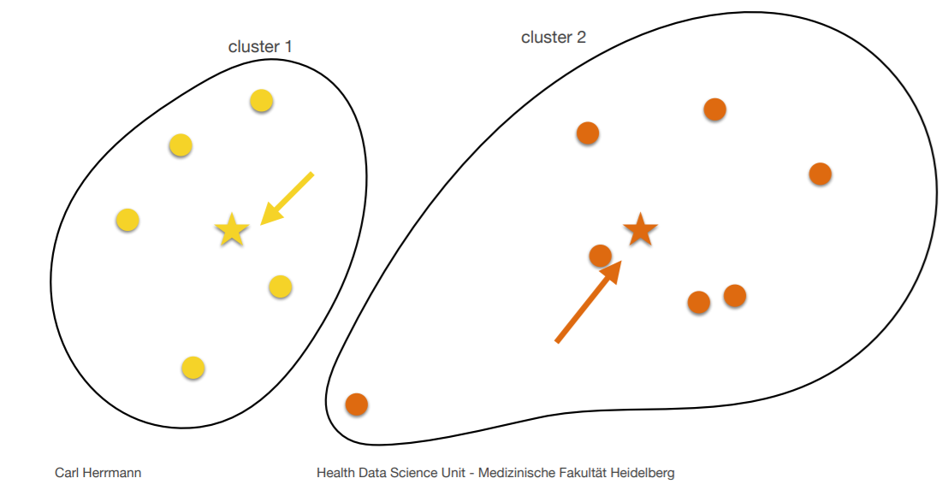
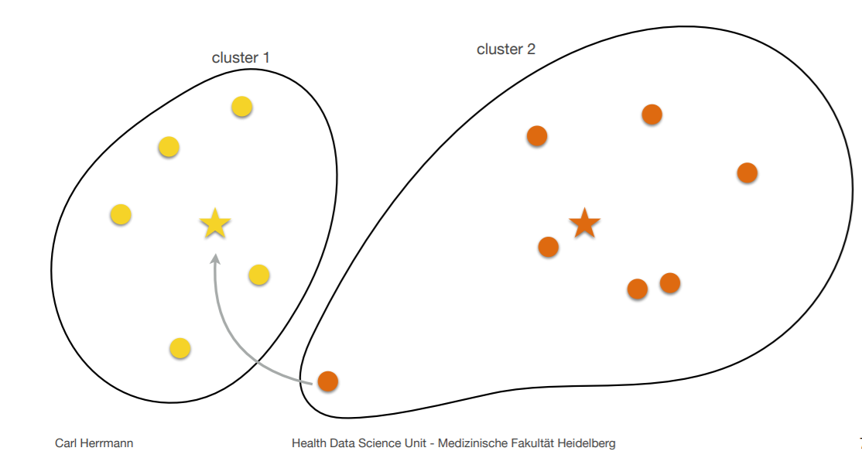
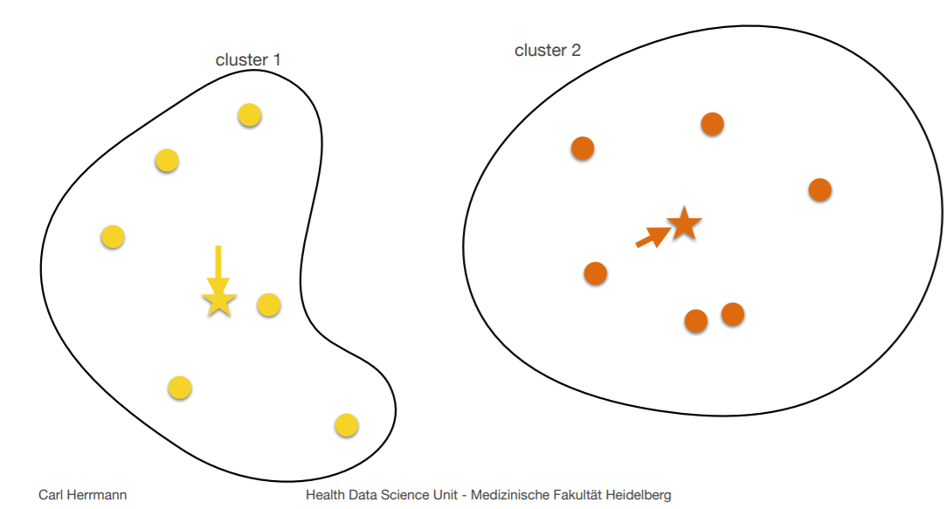
K-means in R
→ finding optimal number of clusters (k) for which sum of squares within cluster becomes minimal
→ “fviz_cluster” function (package: factoextra)
→ ggplot based visualization
→ usage of function “kmeans” (stats R package)
Carl Herrmann, Health Data Science Unit - Medizinische Fakultät Heidelberg

Slide 22
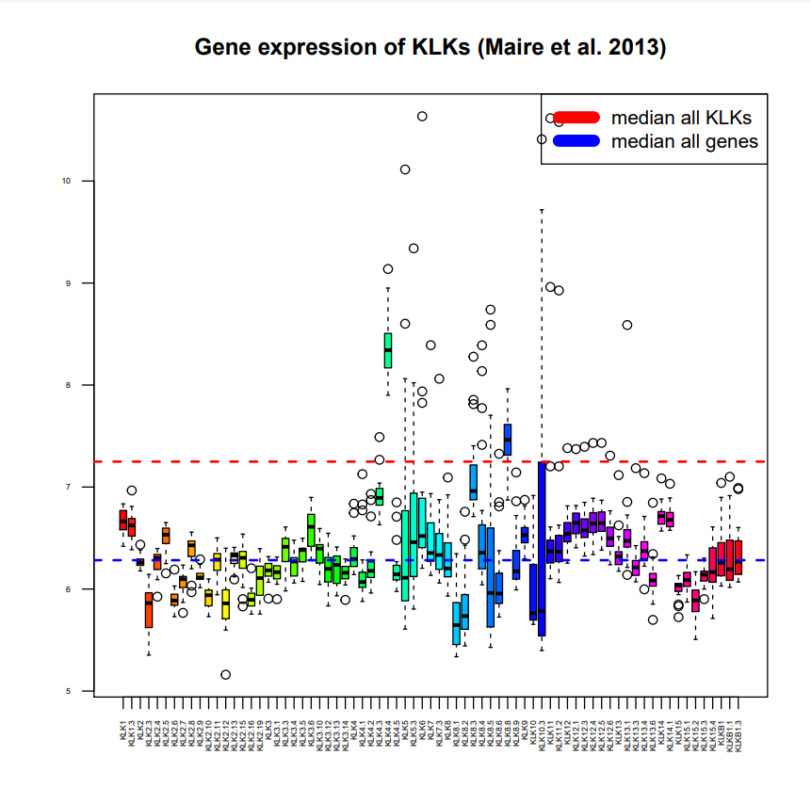
Breast cancer - boxplot
21.07.21
Final presentation – kallikrein gene
22

Slide 23
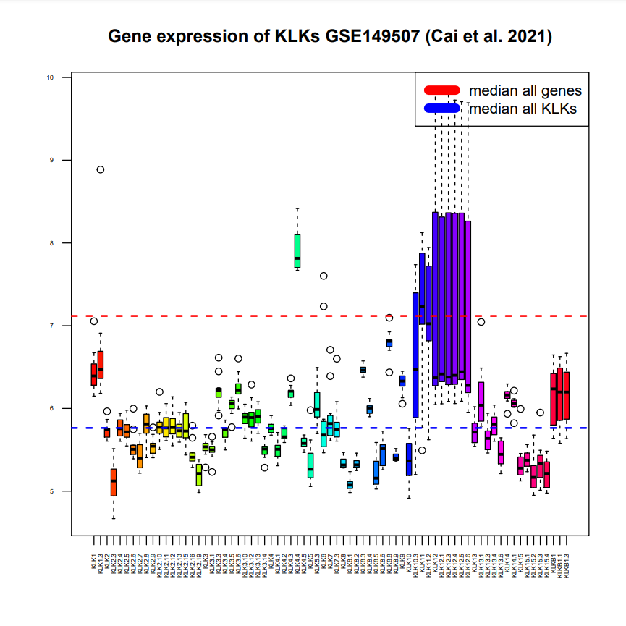
Lung cancer - boxplot
21.07.21
Final presentation – kallikrein gene
23

Slide 24
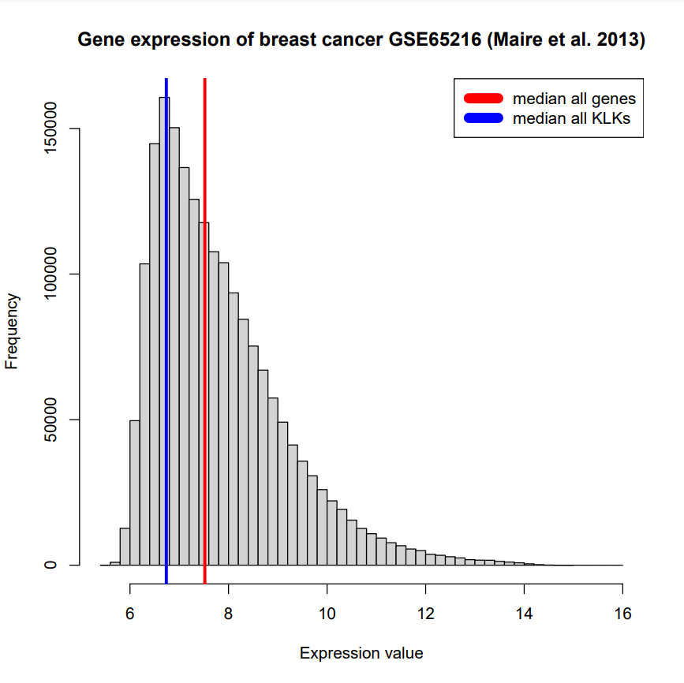
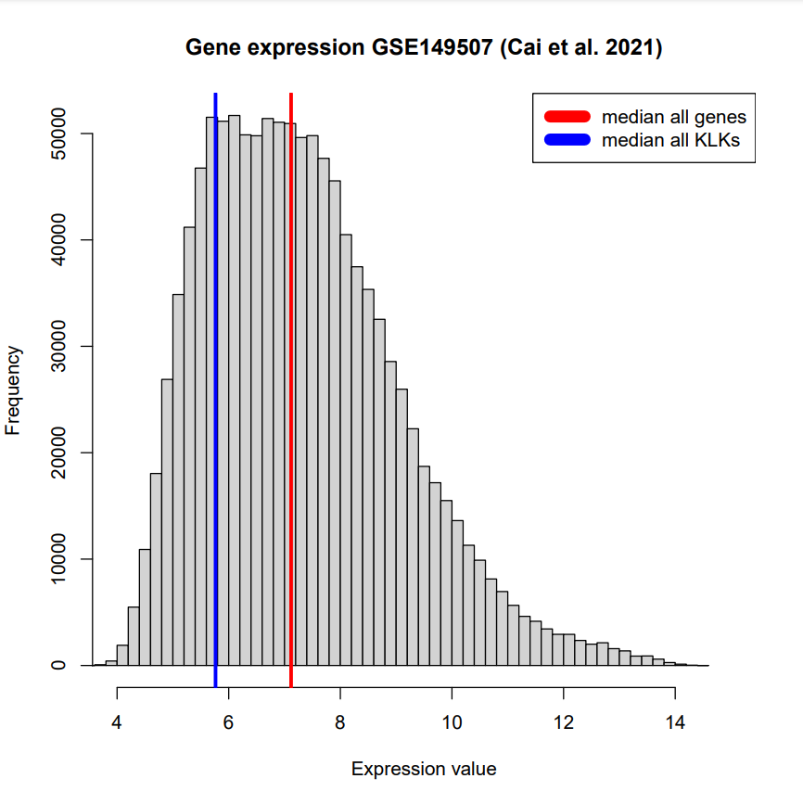
Histograms
Final presentation – kallikrein gene

Slide 25
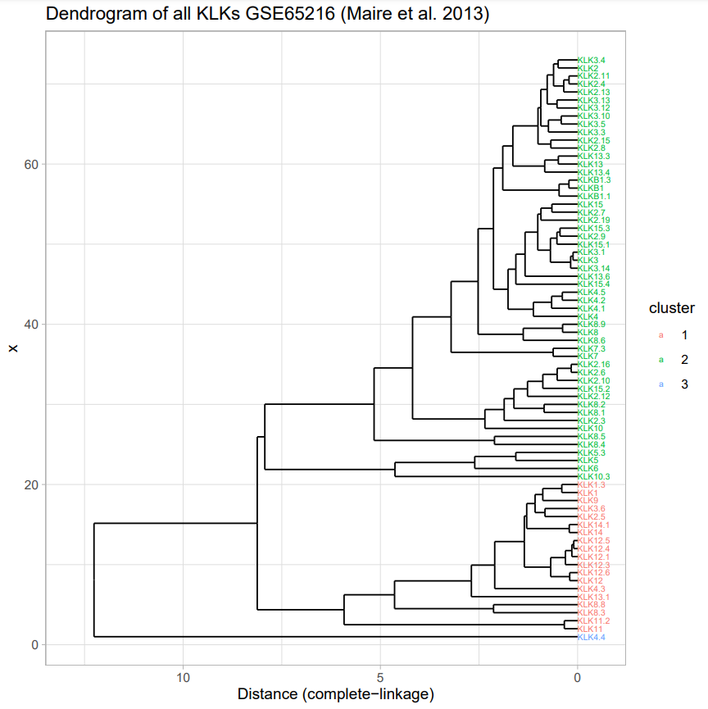
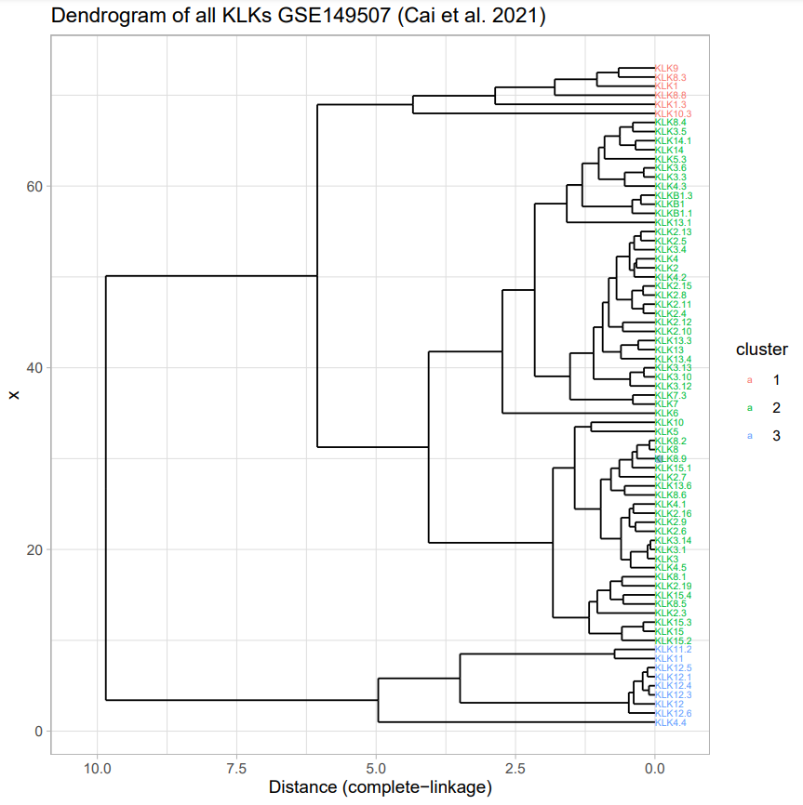
Dendrograms
Final presentation – kallikrein gene

Slide 26
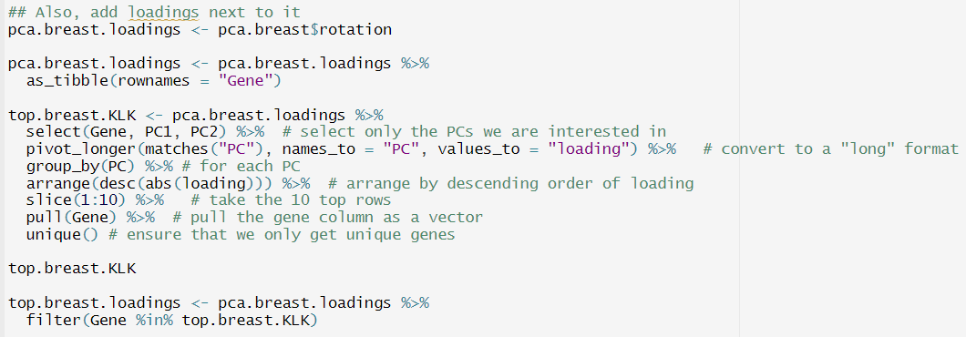
PCA data
Loadings
Final presentation – kallikrein gene

Slide 27
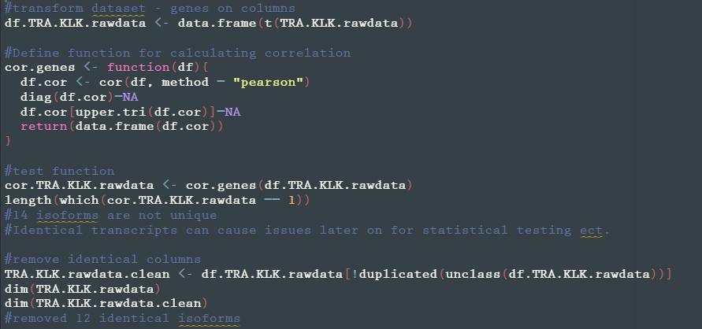
Clean up
Final presentation – kallikrein gene

